Slide 1


FS Duck Creek – Insurance Overview
Capgemini Technology Services India Limited
Bhubaneswar | January 2020

Slide 2

Origin of Insurance
Insurance in some form dates back to prehistory.
Insurance in the early non-monetary economies entailed agreements of mutual aid - if one family's house gets destroyed, the neighbors are committed to helping rebuild it. Public granaries embodied another early form of insurance.
The first methods of transferring or distributing risk in a monetary economy were practiced by Chinese and Babylonian traders in the 3rd and 2nd millennia BC, respectively. Chinese merchants traveling treacherous river rapids would redistribute their wares across many vessels to limit the loss due to any single vessel's capsizing. to indemnify against famines.
Modern insurance business developed mainly with the rapid growth of British commerce in 17th and 18th century.
Lloyds coffee House was a place where all the ship owners would meet to discuss business.
These ship owners devised a system where they would collect money from members and pay compensation to those who faced losses.
By end of 18th century Lloyds emerged as the pioneering Insurance providers and London the hub of world insurance.

Slide 3
What is insurance and why do we need it?
Definition of insurance - Insurance is a risk management technique through which an individual, business and organizations transfers the risk to an insurer that agrees to make good the economic losses, in exchange of periodic payments (premium).
Why do we need insurance?
Life is full of uncertainties - financial losses can happen to anyone at any time.
Individuals and businesses are exposed to financial risks arising out of death, accidents or natural & manmade calamities.
When these risks take place they create financial and economic losses.
Insurance financially indemnifies an insured in the event of a loss incurred from an insured peril

Slide 4
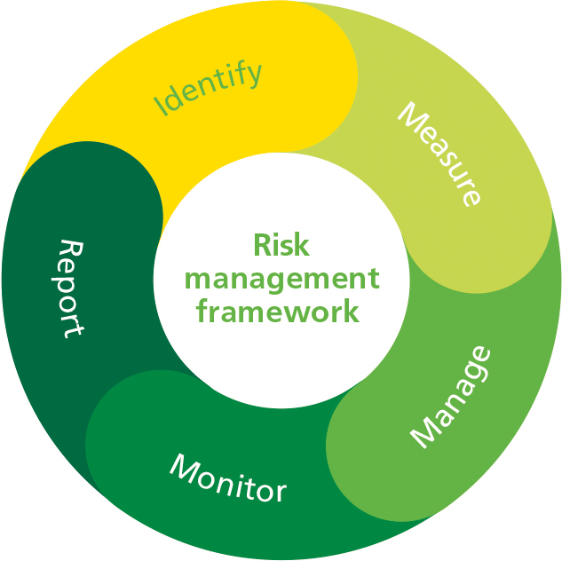
Risk Management
Risk is likelihood or probability that a loss will occur. Alternatively, risk also refers to the subject matter of insurance.
Risk management refers to the practice of identifying potential risks in advance, analyzing them and taking precautionary steps to reduce/curb the risk.

Slide 5
Risk Management
Risk
Pure Risk
Speculative Risk
Either loss happens or it does not, no possibility of gain
insurable
Possibility of gain exists
Uninsurable

Slide 6
Risk Management: Techniques
Risk Mgmt. Techniques
Risk
Control
Risk
Financing
Insurance is a type of risk transfer
Avoidance
Prevention
Reduction
Separation
Duplication
Retention
Transfer

Slide 7
Principles of Insurance
Utmost good faith – The insurer trusts the insured to give the complete and truthful information about the risk that is being insured. Since it is impossible to inspect each and every risk, this implied clause forms the basis of all insurance contracts.
Insurable interest – Insured should ‘own’ the risk and should stand to lose financially if the risk is damaged or lost. For e.g. we cannot insure the health of the child of another person. However, a parent can insure on behalf of their children or the spouse. An employer has insurable interest in their employees.
Indemnity – places the insured in the same financial position he/she was just prior to the loss. The insured cannot become financially better off after the claim. This is true only for non-life insurance. Life insurance policies and personal accident covers, however are not indemnity policies.
Subrogation – When an insurer pays the claim of the policyholder, they assume all the rights of the insured towards the risk up to the extend of the claim amount paid. This is to ensure that the insured does not recover both from the Insurer and the third party and make a gain.
Law of Large numbers – Actual result obtained from a large number of trials should be close to the expected value, and will tend to become closer as more trials are performed.

Slide 8
Insurance As a Contract
An insurance contract is a legal agreement between the insurance company and an individual/ organization, where the insurance company promises to make good the insured losses caused by an insured peril in exchange for a premium.
Contract of utmost good faith - An obligation to act in complete honesty & to disclose all relevant facts
Contract of adhesion - Any contract in which one party must either accept the agreement as written by the other party or reject it.
Contract of indemnity - A contract in which the insurer agrees, in the event of a covered loss, to pay an amount directly related to the amount of the loss.

Slide 9
Insurance As a Contract
Insurance contracts are aleatory in that the amounts exchanged by the insured and insurer are unequal and depend upon uncertain future events. In contrast, ordinary non-insurance contracts are commutative in that the amounts (or values) exchanged are usually intended by the parties to be roughly equal.
Insurance contracts are unilateral, meaning that only the insurer makes legally enforceable promises in the contract. The insured is not required to pay the premiums, but the insurer is required to pay the benefits under the contract if the insured has paid the premiums and met certain other basic provisions.

Slide 10
How does insurance work?
A large number of individuals, business firms and organizations transfer their risks to an Insurer by buying an insurance policy at the cost of a premium.
These premiums go in to a large pool at the insurance company.
Since only a few policy holder from the insured group may suffer losses in any given year there are sufficient funds available in the pool to pay for the losses.
Example – Suppose a village has 100 houses. It has been observed that every year, on an average, 2 houses are damaged due to wildfire. Cost of repairing/rebuilding each burnt house is roughly $1000. So, every year at least $1000 x 2 = $2000 is required for repairing the damaged houses.
If the villagers want to create a common fund for the repair, each family would have to contribute = $2000/100 = $200 per year.

Slide 11

Different Types of Insurance
Insurance can be broadly classified into four types:
Life
Property & Casualty (abbreviated as P&C, also known as non-life)
Health
Pension Plans (Annuity)
Reinsurance

Slide 12


Life Insurance
Life Insurance is a product designed to protect the family and loved ones who are dependent on your income for financial support.
Life insurance is taken to mitigate risk of dying early.
Amongst all the insurance product only life policies have an element of investment.
Life insurance policies are not contracts of indemnity rather they are valued contracts.

Slide 13
Life Insurance
There are several parties involved in life Insurance:
Insurer – the company issuing the policy
Insured – the subject matter of the insurance policy, i.e., on whose life the policy is taken.
Owner – one who pays for the insurance policy. In most cases, owner and insured are the same person.
Beneficiary - the person who will receive the policy amount in the event of death of insured
Brad took a life policy for $1,00,000 on his wife Emily from Aviva insurance. When Emily died their daughter Lourdes received the policy proceeds. In this example, Aviva Insurance → Insurer, Brad → Policy Owner, Emily → Insured, Lourdes → Beneficiary

Slide 14


Property & Casualty Insurance
Property insurance helps cover stuff you own like your home or your car.
Casualty insurance means that the policy includes liability coverage to help protect you if you're found legally responsible for an accident that causes injuries to another person or damage to another person's belongings.
Property and casualty insurance are typically bundled together into one insurance policy.

Slide 15
Property & Casualty Insurance
P&C Products
Personal
Auto
Homeowner
Commercial
CGL
Umbrella
CPP
CIM
CP
Umbrella
CGL = Comm. General Liability
CPP = Comm. Package Policy
CIM = Comm. Inland Marine
CP = Commercial Property

Slide 16
Differences between Life and Non-Life Insurance
Life Insurance | Non-Life Insurance
Subject of insurance is life | Subject of insurance is property / liability
Loss is bound to happen. Timing of loss is uncertain. | Loss may / may not happen
Long term | Short term
Guarantee-Assurance | Indemnity-Insurance
Risk cover combined with savings | Risk cover only
Maturity benefit | No returns from policy

Slide 17

Health Insurance
Health insurance covers cost of routine, preventive and emergency cost of medical procedures and the prescription drugs.
Types of health plans:
Individual Plans
Group Plans
Government Plans

Slide 18
Health Insurance
Types of health insurance plans:
Individual Plans - Private plans that can be taken by an individual. Covers the cost of hospitalization, surgeries and medications thereafter. They are renewed annually.
Group Plans – Generally offered by the corporate as part of employee benefit. The premiums are often paid by the employer in part or full.
Government Plans - When a country offers insurance to its citizens to meet medical expenses. Example – Medicare, Medicaid by US government.

Slide 19

Pension Plans (Annuity)
An annuity is a contract between you and an insurance company in which you make a lump sum payment or series of payments and, in return, receive regular disbursements, beginning either immediately or at some point in the future, typically after retirement.

Slide 20
Pension Plans (Annuity)
Annuities come in three main varieties: fixed, variable, and indexed. Each type has its own level of risk and payout potential.
Fixed annuities pay out a guaranteed amount. The downside of this predictability is a relatively modest annual return, generally slightly higher than a Fixed Deposit from a bank.
Variable annuities provide an opportunity for a potentially higher return, accompanied by greater risk. In this case, you pick from a menu of mutual funds that go into your personal "sub-account." Here, your payments in retirement are based on the performance of investments in your sub-account.
Indexed annuities fall somewhere in between when it comes to risk and potential reward. You receive a guaranteed minimum payout, although a portion of your return is tied to the performance of a market index.

Slide 21

Reinsurance
Reinsurance is a contract by which an insurance company transfers all or a portion of the risk assumed by it, under a policy, to another company. This is often called as “Insurance for the Insurer”.
The company that issued the policy to the insured is called as ‘direct-writing’ or ‘ceding company’ or ‘carrier’.
The company to which a portion of risk is transferred is called as ‘reinsurer’ or ‘assuming’ company.
The reinsurer may in turn obtain insurance from another insurer who is known as a ‘retrocessionaire’. This transaction is known as “retrocession”.
The maximum amount of insurance that an insurer may retain without jeopardizing its financial stability is called as “Retention Limit”.

Slide 22
THANK YOU!

